Slide 1
FPGA
MEMS GYRO
LPF
(48 Hz)
每個 Sensor LPF後的BW 需 <= (SYNC freq)/2
MEMS ACCL
LPF
(41.6 Hz)
SYNC
MIC 可再對各 sensor 單獨一階 LPF
200 Hz
FOG
LPF
(100 Hz)

Slide 2
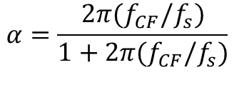
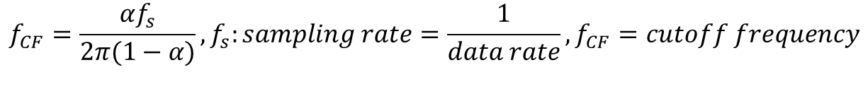
$$f_{CF}=\frac{αf_{s}}{2π(1−α)}, f_{s}:sampling rate=\frac{1}{data rate}, f_{CF}=cutoff frequency$$
$$α=\frac{2π{(f}_{CF}/f_{s})}{1+2π{(f}_{CF}/f_{s})}$$
 | DR = 200 Hz
BW (Hz): disable | Alpha = 1
50 | 0.611
20 | 0.386
10 | 0.239
5 | 0.136
1 | 0.031

Slide 3
